Slide 1
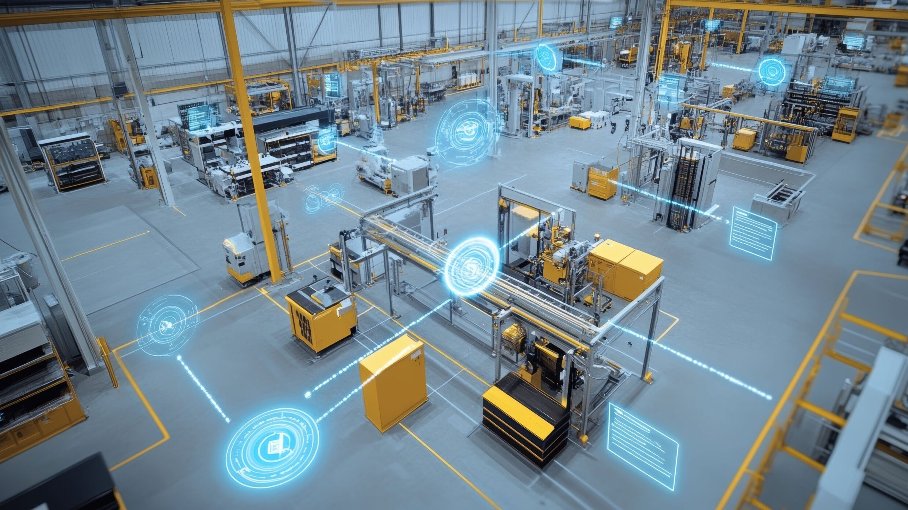
Industrial Internet of Things
Smart • Connected • Data-Driven Industry
IIoT
SMART FACTORY
Presented by: Boyapati Nandini
Image: IIoT-enabled factory visualization

Slide 2
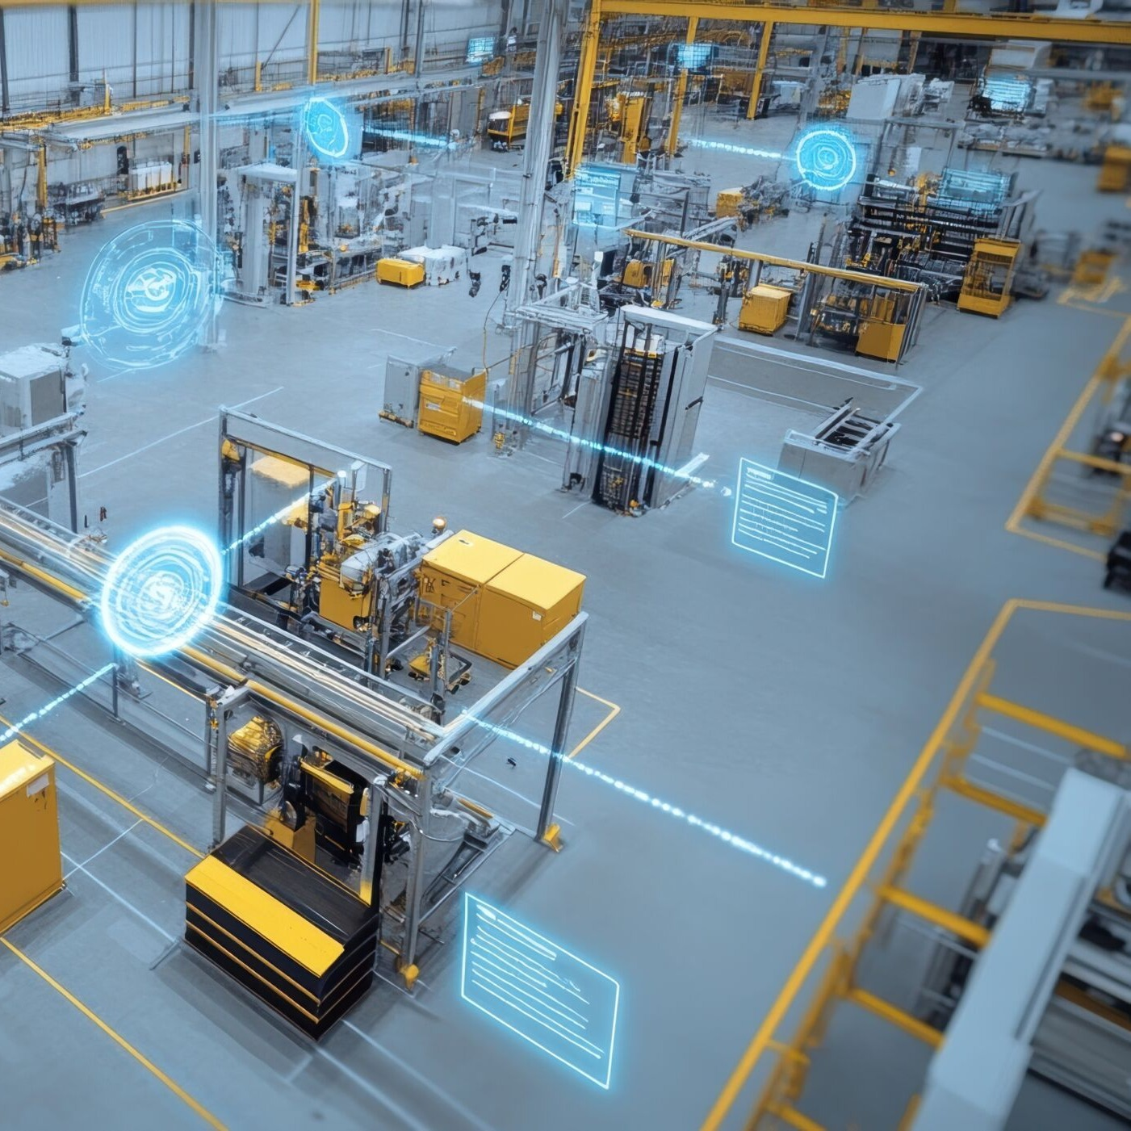
Industrial Internet of Things
IIoT connects industrial machines, sensors, software and people through networks to collect and analyze real-time operational data.
CONNECT
ANALYZE
ACT
Industrial machines + sensors + people
Real-time operational data becomes useful information
Automation, reliability, safety and decisions
IIoT supports smart manufacturing and Industry 4.0.
REAL-TIME DATA
AUTOMATION
02

Slide 3
What is IIoT?
◉
⌁
IIoT
Sensors
Network
⚙
▥
Machines
Analytics
Sense → Communicate → Process → Optimize
03

Slide 4
Components of IIoT
SENSORS
ACTUATORS
MACHINES
Temperature, pressure, vibration, speed
Physical actions based on control signals
Robots, pumps, motors and controllers
CONNECTIVITY
EDGE / CLOUD
APPLICATIONS
Wired/wireless networks and protocols
Process, store and analyze data
Dashboards, alerts and automated control
04

Slide 5
IIoT system architecture
1
2
3
4
5
FIELD
GATEWAY
EDGE / CLOUD
ANALYTICS
DASHBOARD
Sensors + Machines
Data transfer
Processing + storage
Insights + predictions
KPIs + alerts + decisions
Feedback and control actions can flow back to industrial equipment.
DATA FLOW
05

Slide 6
Technologies used in IIoT
IoT / M2M
RFID + SENSORS
ETHERNET / 5G
Connected device communication
Identification and measurement
Industrial connectivity
EDGE + CLOUD
BIG DATA + AI
CYBERSECURITY
Low-latency and scalable computing
Analytics and prediction
Protection of connected systems
06

Slide 7
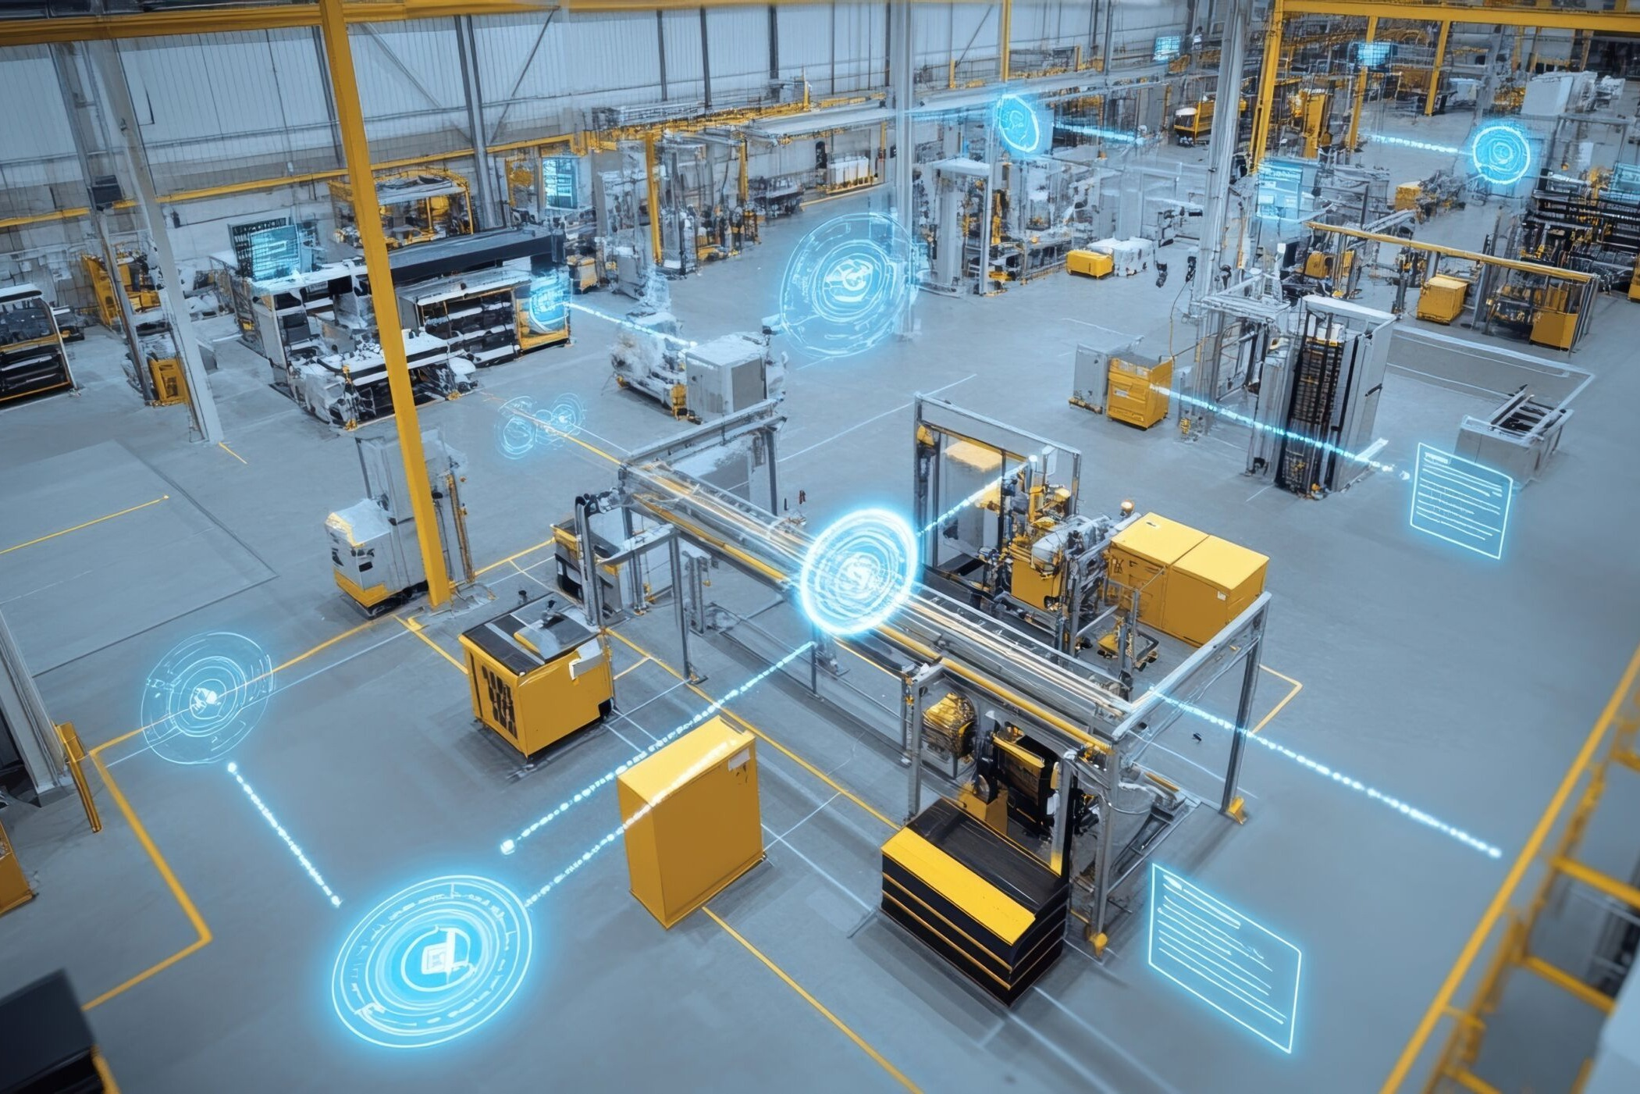
Where IIoT is used
✓
Smart manufacturing & factory automation
✓
Predictive maintenance
✓
Supply chain & inventory monitoring
✓
Energy & utility management
✓
Industrial safety & quality control
✓
Asset tracking & smart warehouses
IIoT connects machines, cloud, analytics and people to improve industrial performance.
07

Slide 8
Predictive maintenance
Machine health trend
MONITOR
RISK
Sensors continuously monitor machine conditions.
ANALYZE
Vibration, temperature and pressure signals are analyzed.
PREVENT
Maintenance can be planned before major failures.
NORMAL
08

Slide 9
Advantages of IIoT
PRODUCTIVITY
VISIBILITY
DOWNTIME
Improve operational efficiency
Real-time monitoring
Reduce unplanned downtime
QUALITY
DECISIONS
SAFETY
Improve consistency
Faster data-driven decisions
Continuous monitoring supports safety
09

Slide 10
Challenges of IIoT
CYBERSECURITY
LEGACY MACHINES
DATA VOLUME
Connected industrial systems increase security exposure.
Older equipment may be difficult to integrate.
Large data streams require efficient storage and processing.
CONNECTIVITY
COST
SKILLS
Critical operations may require reliable low-latency networks.
Initial deployment and integration can be expensive.
Industrial, networking and data expertise is needed.
10

Slide 11
Future scope
1
More autonomous and intelligent factories
2
Advanced AI-based predictive maintenance
3
Digital twins for equipment and production processes
4
5G and other high-speed industrial connectivity
5
Greater use of edge AI for low-latency decisions
6
Stronger cybersecurity and zero-trust approaches
7
More connected robots, machines and supply chains
13

Slide 12
Conclusion
IIoT transforms industrial data into useful information and intelligent action.
1
2
3
4
CONNECT
MONITOR
ANALYZE
OPTIMIZE
IIoT is a major foundation for smart manufacturing and Industry 4.0.
SMART • CONNECTED • DATA-DRIVEN
14

